Slide 1

DEPARTMENT OF COMPUTER ENGINEERING UNIVERSITY OF GHANA
IoT Based Bridge Health Monitoring & Alerting System
BY
QUARSHIE FRANCIS-10909989
OHENE-AGYEKUM DANIEL-10483685
SUPERVISOR
Margaret Richardson Ansah, D.Eng.
Date: 17th November, 2023

Slide 2
OUTLINE
Introduction
Problem Statement
Objectives
Project Relevance
Existing Works
Proposed Solution
Methodology
Budget
Role Distribution
Timeline of Project
Expected Outcome
Conclusion
References

Slide 3
INTRODUCTION
Bridges can do more for communities than improving connectivity and promoting active travel.[1]
Damage to bridges in Ghana usually means cutting off of communities from others.

Slide 4
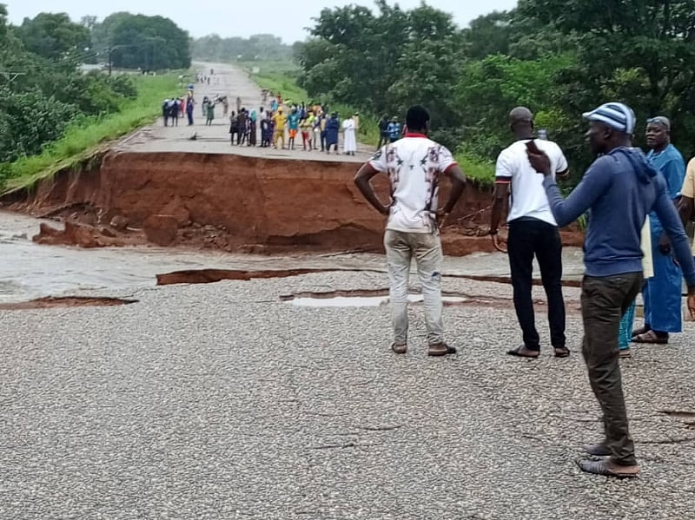
INTRODUCTION
Savannah Region: Commuters stranded following Doli bridge collapse [2]

Slide 5
INTRODUCTION
This project helps in monitoring the on-time health of the bridge like vibrations, beneath water level & temperature.

Slide 6
PROBLEM STATEMENT
The deterioration of bridge structures over time is a significant concern, leading to safety risks and costly repairs. Traditional inspection methods are often inadequate, as they rely on periodic visual inspections that may not detect hidden structural flaws.
There is a need for a comprehensive and proactive system that can continuously monitor the health of bridges and provide early warnings of potential failures.

Slide 7
OBJECTIVES
Development of bridge sensor systems
Establishment of communication network from microcontroller through to the cloud server
Access of logged data from cloud

Slide 8
PROJECT RELEVANCE
Enhancement of safety
Efficiency in cost management
Efficiency of operations
Notes:
Safety Enhancement: By continuously monitoring the health of bridge structures and providing early warnings, the system can enhance public safety by preventing catastrophic failures and accidents.
Cost Efficiency: Timely detection of structural issues can lead to cost-effective maintenance and repair strategies, minimizing the need for major rehabilitation or replacement projects.
Operational Efficiency: The system can optimize bridge maintenance schedules, allowing resources to be allocated more efficiently, reducing disruption to traffic flow, and extending the lifespan of bridge structures.

Slide 9
EXISTING WORKS
Author(s) | Title | Focus | Limitations
Scott Lewit, John Unser, Matthew Davis, George Laggis, Dayakar Penumadu, et al. [3] | Structural health monitoring of new technology composite highway bridge deck with 100-year design life | The use of composite technology and the fabrication method to facilitate structural health monitoring using low-cost embedded sensors and fiber optics. | A small rural bridge was selected.

Slide 10
EXISTING WORKS
Author(s) | Title | Focus | Limitations
Wonseok Chung & Donghoon Kang [4] | Structural behavior of concrete box bridge using embedded FBG sensors | This study presented the application of fiber Bragg grating (FBG)-based sensing systems to precast concrete box railway bridges | It was used only on railway bridges.

Slide 11
EXISTING WORKS
Author(s) | Title | Focus | Limitations
Sheng Li, Dian Fan, Jiang-hua Fu, Xing Huang, De-sheng Jiang[5] | Bridge SHM system based on fiber optical sensing technology | This paper introduces the progress of bridge structural health monitoring based on optical fiber sensing technology in sensors, system architecture design and typical engineering application | Only Fiber Optical sensors (FOS)were used

Slide 12
EXISTING WORKS
Author(s) | Title | Focus | Limitations
M. B. Kodindouma & Rola L. Idriss[6] | Integrated sensing system for highway bridge monitoring | Laboratory small and large scale testing were performed to explore the feasibility of the system. Large scale reinforced concrete beams were fabricated in the laboratory, and artifical flaws in terms of delaminations were simulated in the beams during construction. The sensing system was used to evaluate the effect of these damages on the behavior of the beams | Further testing is necessary to explore the long term performance and durability of the sensor system.

Slide 13
EXISTING WORKS
Author(s) | Title | Focus | Limitations
Toshiyuki Oshima, Muhamad S. Rahman, Shuichi Mikami, Tomoyuki Yamazaki, Naoyuki Takada, John J. Lesko, and Ron D. Kriz [7] | Application of smart materials and systems to long-term bridge health monitoring | The objective is to develop a diagnostic system to monitor structural integrity of bridge by stain sensing using fiber optic sensor (FOS) | Only Fiber Optic senors (FOS) were used

Slide 14
PROPOSED SOLUTION
The project aims to create a comprehensive and efficient Bridge Health Monitoring System using IoT technologies to ensure the safety, longevity, and structural integrity of bridges.
The system will focus on monitoring crucial indicators of the bridge's health including; vibrations, temperature changes, and water levels.

Slide 15
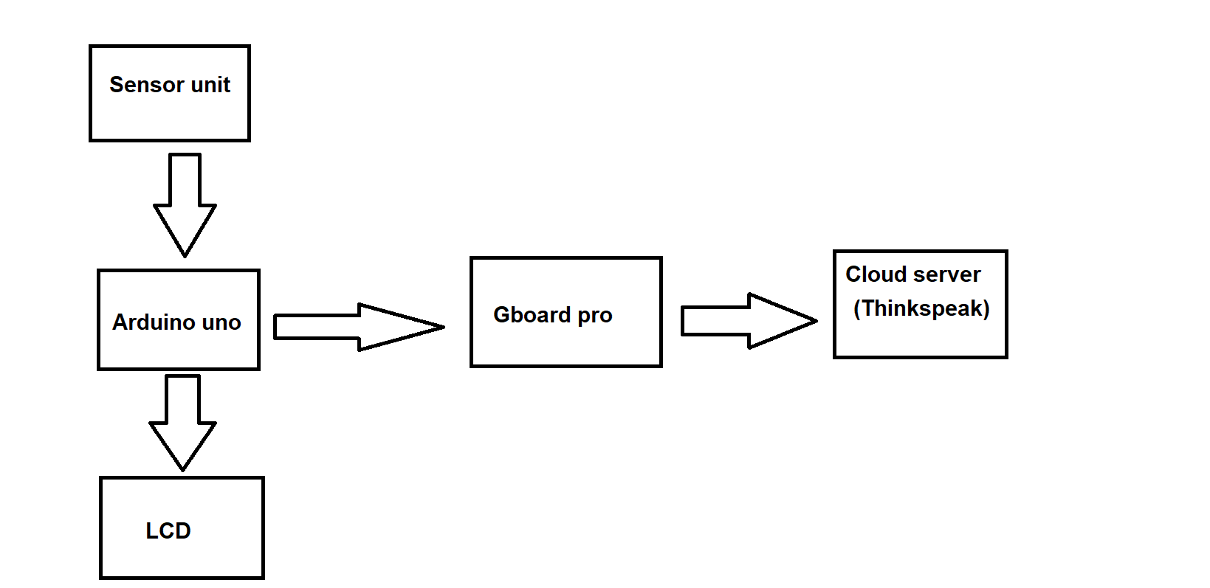
METHODOLOGY

Slide 16
PROJECT REQUIREMENTS AND BUDGET
Hardware
Component | Estimated Price (GHS)
Arduino UNO | 300
Alphanumeric LCD | 155
Gboard Pro 800 SIM800 GSM / GPRS Module | 750
Vibration Sensor | 120
Ultrasonic Sensor | 300
Total | 1,625

Slide 17
PROJECT REQUIREMENTS AND BUDGET
Software
Component | Estimated Price (GHS)
ThingSpeak API | Free
Arduino IDE | Free

Slide 18
ROLE DISTRIBUTION
Team Member | Role
Quarshie Francis | Development of project hardware connections
Ohene-Agyekum Daniel | Development of project software programs

Slide 19
EXPECTED OUTCOME
Early recognition of bridge anomalies
Constant surveillance of structural health
Designs capable of accommodating future technological advancements or sensor integrations.
Efficient data transmission and logging

Slide 20
PROJECT TIMELINE
Task | Oct. 23 |  | Nov. 23 |  | Dec. 24 |  | Jan. 24 |  | Feb. 24 |  | Mar. 24 |  | Apr. 24 |  | May 24 |  | Jun. 24
 | 15 | 29 | 12 | 26 | 17 | 31 | 14 | 28 | 11 | 25 | 17 | 31 | 14 | 28 | 12 | 26 | 9 | 30
Problem Identification
Literature Review
Project proposal
Hardware Simulations and Acquisition
Development And Testing of Sensor System
Programming of Microcontroller
Implementation of Communication Network
Testing And Thesis Preparation

Slide 21
CONCLUSION
The Bridge Health Monitoring System embodies a commitment to safety, efficiency, and innovation. By harnessing technology to safeguard critical infrastructure, we aim to ensure safer travels, extended infrastructure longevity, and continual improvements in structural maintenance practices.

Slide 22
REFERNCES
[1] https://www.mottmac.com/views/a-bridge-is-more-than-a-crossing
[2] https://www.graphic.com.gh/news/general-news/doli-bridge-collapse.html
[3] Scott Lewit, John Unser, Matthew Davis, George Laggis, Dayakar Penumadu, and Sarah Walker "Structural health monitoring of new technology composite highway bridge deck with 100-year design life", Proc. SPIE 12047, Nondestructive Characterization and Monitoring of Advanced Materials, Aerospace, Civil Infrastructure, and Transportation XVI, 120470R (18 April 2022); https://doi.org/10.1117/12.2615544
[4] Wonseok Chung and Donghoon Kang "Structural behavior of concrete box bridge using embedded FBG sensors", Proc. SPIE 8345, Sensors and Smart Structures Technologies for Civil, Mechanical, and Aerospace Systems 2012, 83451X (3 April 2012); https://doi.org/10.1117/12.920946

Slide 23
REFERENCES
[5] Sheng Li, Dian Fan, Jiang-hua Fu, Xing Huang, and De-sheng Jiang "Bridge SHM system based on fiber optical sensing technology", Proc. SPIE 9634, 24th International Conference on Optical Fibre Sensors, 963447 (28 September 2015); https://doi.org/10.1117/12.2194716
[6] M. B. Kodindouma and Rola L. Idriss "Integrated sensing system for highway bridge monitoring", Proc. SPIE 2719, Smart Structures and Materials 1996: Smart Systems for Bridges, Structures, and Highways, (22 April 1996); https://doi.org/10.1117/12.238832
[7] Toshiyuki Oshima, Muhamad S. Rahman, Shuichi Mikami, Tomoyuki Yamazaki, Naoyuki Takada, John J. Lesko, and Ron D. Kriz "Application of smart materials and systems to long-term bridge health monitoring", Proc. SPIE 3995, Nondestructive Evaluation of Highways, Utilities, and Pipelines IV, (9 June 2000); https://doi.org/10.1117/12.387818

Slide 24
THANK YOU

